Slide 1





Project 2 The World Happiness 2019
By Soukhna Wade
Bellevue DSC680
Applied Data Science

Slide 2
Data Sources: World Happiness Report 2019
Features:
Overall Rank (happiness Rank)
Country or region: Name of countries
Score: Happiness measurement on a scale of 0 to 10
GPA per capita (economy): Value of all final goods and services produced within a nation each
Social Support (Family): Importance of having a family
Health Life Expectancy(health): Importance of health and amount of time people expect to live
Freedom: Importance of freedom in each country
Generosity: The quality of being kind and generous
Perception of corruption(trust) in a government

Slide 3
Cleaning Dataset
Data cleaning is the process of detecting and correcting corrupt or inaccurate records from a record set, table, or database and refers to identifying incomplete, incorrect, inaccurate, or irrelevant parts of the data and then replacing, modifying, or deleting the dirty or coarse data.

Slide 4
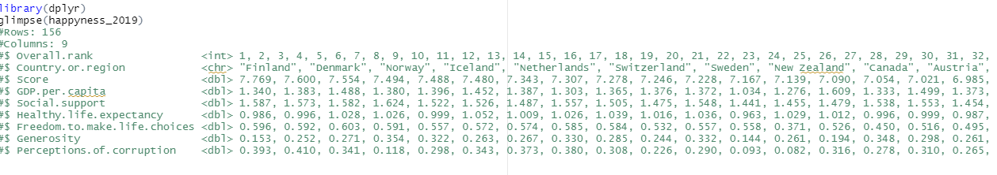
Glimpse dataset-2019 by using R Programing

Slide 5
Visualization
visualization's purpose is the communication of data. Visualization transforms from the invisible to the visible. In this section, we use different variables to determine their correlation.
Notes:
visualization's purpose is the communication of data. Visualization transforms from the invisible to the visible. In this section, we use different variables to determine their correlation
Data cleansing may be performed interactively with data wrangling tools, or as batch processing through scripting. First, I load my dataset using Pandas to check for missing or null values. For instance, you can find in the below line that the dataset is cleaned. So, there is no need to clean it again. In the following example I used Pandas to determine if there are any missing values in the

Slide 6
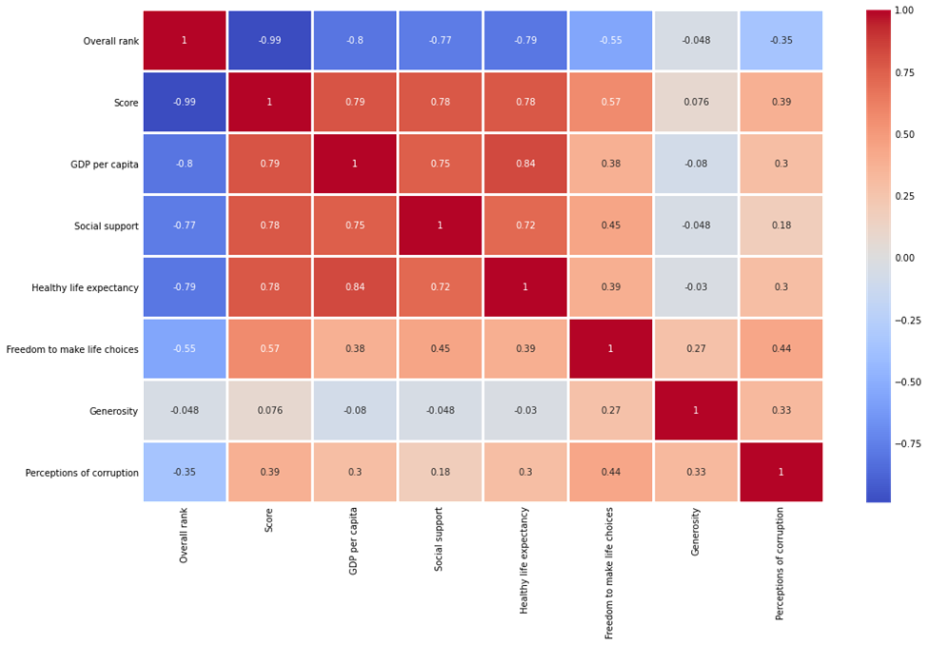
Heatmap
The heatmap of correlation among the variables displays the color palette in the side represents the amount of correlation among the variables. Therefore, the lighter shade represents a high correlation. You can see that the happiness score correlated with the economy, family, and life expectancy. It is least correlated with generosity.

Slide 7
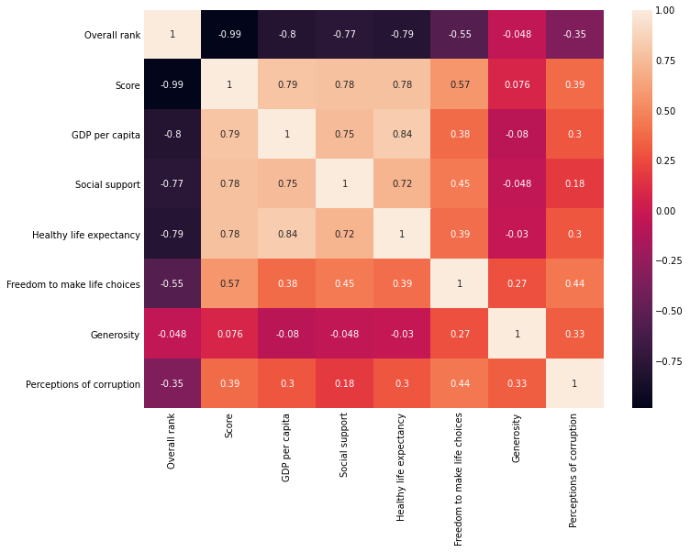
Correlation plot between numerical variables
There is an inverse correlation between the Happiness Rank and all the other numerical variables. The lower the happiness rank, the higher the happiness score, and the higher the other factors that contribute to happiness.
Notes:
Note: overall Rank or happiness Rank

Slide 8

Random Forest
Random Forest is one of the most effective machine learning models for predictive analytics. It is a technique that can combine many ideas to create an accurate model that can learn from past data.
MSE: 0.34732590460851087 RMSE: 0.17366295230425544 Model-score: :89% Cross_val_score: 74%
Notes:
*Preparing the data
*Training the model
*Predicting and accuracy check
*Happiness dataset prediction
*visualize the original and predicted data
*calculate the root mean squared error: RMS or MSE

Slide 9
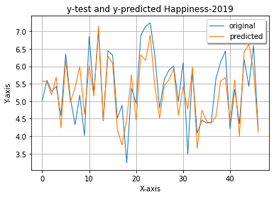
To visualize the original and predicted data (happyness_2019) in a plot

Slide 10
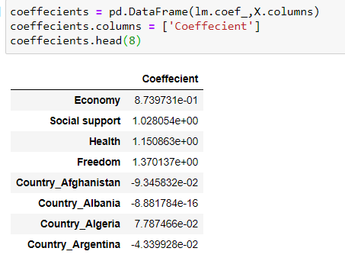
Coefficients
Notes:
The above result shows that there is a positive correlation. This indicates that when the predictor variable increases, the response variable will also increase.

Slide 11
Conclusion
In conclusion, according to the 2019 World Happiness Report, negative feelings are rising around the world. The United States is particularly hard-hit with an “epidemic of addictions.” Also, we can not exclude the pandemic that is still around the continents and hit hard in the USA. The report also shows a widening happiness gap, with some people reporting much more well-being, and others show much less within each country.

Slide 12
Questions & Answers
Q: What year is the dataset? A: The data is of year 2019
Q: What makes people happy? A: Close behind are meaningful work, positive thinking, and the ability to forgive
Q: How is the happiness score is distributed? A: The happiness score has values above 2.86 and below 7.77.
Q: What means overall rank? A: It means happiness Rank.
Q: What are the factors that contribute to happiness? A: Economy, social support, and health play significant role
Q: What make people happy? Health follows by meaningful work, positive thinking, and the ability to forgive.
Q: What are the five first countries with high GDP? A: Qatar, Luxemburg, Singapore, United Arab Emirates, and Kuwait.
Q: Why generosity is important? A: It reduces stress, supports one's immune system and enhances one's sense of purpose
Q: What are the first five countries with high generosity? A: Myanmar, Indonesia, Haiti, Malta, and Kenya.
Q: Is corruption impact Happiness Score? A: Corruption is a very big problem for the word happiness
Q: What means “Freedom to make life choices”? A: It is the national average of responses to the question “Are you satisfied or dissatisfied with your freedom to choose what you do with your life?”
Notes:
https://worldhappiness.report/ed/2017

Slide 13
References
1. https://www.kaggle.com/PromptCloudHQ/world-happiness-report-2019/activity
2. https://worldhappiness.report/archive/
3. https://www.kaggle.com/unsdsn/world-happiness
4. https://www.kaggle.com/dgtech/world-happiness-with-basic-visualization-and-eda
5. https://www.kaggle.com/pinarkaya/world-happiness-eda-visualization-ml/data#Linear-Regression
6. https://www.kaggle.com/javadzabihi/happiness-2017-visualization-prediction/report
7. https://www.kaggle.com/roshansharma/world-happiness-report?select=2019.csv
8. https://www.kaggle.com/pinarkaya/world-happiness-eda-visualization-ml#Random-Forest
9. https://www.kaggle.com/dhanyajothimani/basic-visualization-and-clustering-in-python/data
10. https://towardsdatascience.com/understanding-random-forest-58381e0602d2
11. https://en.wikipedia.org/wiki/The_Happiness_Hypothesis
12. Statistical Appendix for Chapter 2 of the World Happiness Report 2020 John F. Helliwell, Haiyang Huang, Shun Wang, and Max Norton February 29, 2020

